Slide 1


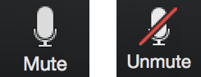
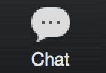
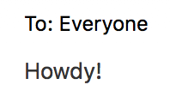
GA & Indeed
Software Engineering Bootcamp
Orientation/Installfest
Step 1.
Turn on your video.
Step 2.
Mute your microphone.
Step 3.
Give us a ‘Howdy!’ in the chat box!
February 2024

Slide 2
TODAY’S AGENDA
Objective: To familiarize you with Zoom capabilities and install tools to make the SOFTWARE ENGINEERING BOOTCAMP as engaging and impactful as possible!
Introductions
Program Breakdown
Classroom Operations
Program Tools and Access
Q&A

Slide 3

INTRODUCTIONS

Slide 4





GENERAL ASSEMBLY
CONTENT AREAS
General Assembly is at the forefront of tech talent development specializing in today’s most in-demand skills. The leading source for upskilling, reskilling, and revolutionizing teams, GA programs offer proven impact on the job, both for the employee and the employer.
Engineering & Development
Data & AI
Product & UX
Digital Marketing
FLAGSHIP CAMPUSES
FAST FACTS
80,000+ alumni, 19,000+ hiring partners
25,000+ employees of Fortune 500 companies trained in 20+ countries
Flagship campuses in NY and Singapore + global virtual learning
General Assembly is a brand of the Adecco Group, the world’s foremost provider of staffing, career transition, and talent development solutions.

Slide 5





MEET THE GA TEAM
Cari Perez Account Director I Gov & Workforce Partnerships
Cassie Pitkin Instructor Manager
Alyssa Ton Sr. Client Success Manager
Daniel Rodriguez Client Success Manager
Notes:
Who Will Be Responsible For…
Day-to-day point of contact
Delivery coordination
Executive communication/sponsorship
Anyone else we should know?

Slide 6

YOUR LEAD INSTRUCTOR
Bereket Beshane
Headshot
Pronouns: He/Him
Software Engineer and Instructor
7+ years as a Software Engineer. Started as a Junior developer in Ethiopia all the way to Expedia and Citibank as a software development Engineer and Java cloud developer, respectively, in Austin, Texas.
Masters in Computer Science from Maharishi International University, Iowa.
Specialises in Fullstack development and Microservices
Part time game developer, photography assistant for my wife and a dog owner.
Notes:
Goal: Instructor introduction
q

Slide 7

YOUR INSTRUCTIONAL ASSOCIATE
Asha Mathis
Headshot
Pronouns: she/her
Asha Mathis is a former Software Engineer and has been an educator in Computer Science and Data Science at General Assembly for two years.
Her educational and professional knowledge is built on work with machine learning models, data management, algorithmic complexity, and statistical analysis.
Notes:
Goal: Instructor introduction
q

Slide 8

INTRODUCE YOURSELF
What is your name and pronouns?
What are you most excited about learning in this class?
Ice breaker: What are you currently reading or watching or listening to? (pick one)
Notes:
IA
Alternative Icebreakers
Favorite emoji, animal
Say your favorite animal eating your favorite food
The coolest place your shoes have been
Grab an item that represents you and put on camera
Make a face that looks like your favorite emoji (explain emojis first)
What breed of dog would you be
Movie Pitch
Learning Journey - Option 2
Can Delete or Add additional Phases, can use GA Image Library Addon for Icons + Photos. If adding more phases, follow the color order referenced in the Enterprise Master Deck Slide 2

Slide 9
PROGRAM BREAKDOWN

Slide 10



SOFTWARE ENGINEERING BOOTCAMP WITH JAVA AND REACT
Bereket Beshane
Remote
~480 Hours
Overview:
Transform individuals with non-technical backgrounds into full-stack engineers capable of making instant impacts on software development projects. Through this program, attendees will develop a strong foundation in essential programming and computer science principles, while also acquiring hands-on experience with key technologies and tools required by the industry, including HTML, CSS, Java, Spring Boot, React, Docker, and microservices
Business Outcomes:.
Build an engineering capacity within your tech team.
Transform non-technical talent into job-ready software engineers.
Solve real engineering problems through capstone projects.
~480 Hours of Software Engineering Training
Front-End Development
Back-End
Development
Front-End Frameworks
Cutting-edge Tools & Architectures
Capstone
Project
Reinforce foundational pre-work topics such as HTML, CSS, JavaScript.
Build backend applications with database and deepen your knowledge of server-side development.
Branch out into more advanced JavaScript frameworks and concepts with React
Leverage Docker and Microservices and practice executing a real-world workflow.
Build and deploy a full-stack app while mimicking a team-client interaction.
Notes:
About This Program:
Audience:
Undeclared Majors: People who are looking for direction, structure, and employable skills at a lower cost than a 4-year college degree or traditional institution
Career Switchers: Coming from a more creative or non-technical background and are often looking for technical skills they need to implement their designs.
Enterprise Industry Verticals: Fin Services, Healthcare, Industrials, Media, Prof Services, Public & Social Sector
Prework: ~20 hours of HTML, CSS, and JavaScript myGA lessons; 45 minute SEI Readiness Assessment
Prerequisites: None
Standardized: Yes
Consumer & Enterprise or Enterprise Only: Consumer & Enterprise
Notes: All students in SEI will learn JavaScript as their first language; for the second language, clients can choose one of the following languages: Java, Python, or Ruby
Dive Deeper Into SEI:
Confluence (Internal)
myGA Training (Internal)
Share SEI:
Flagship Deck (External)
Course Syllabus (External)
Deliver SEI:
Curriculum Materials (Internal)

Slide 11
JAVA DEVELOPER BOOTCAMP
Instructor-Led
Onsite or Remote
~480 Hours
Overview:
Expand your Java development workforce with experiential training in the most in-demand skills. Participants will build core skills in Java, Spring Boot, test-driven development, troubleshooting, and Agile development.
Business Outcomes:.
Build engineering capacity to tackle enterprise technology projects.
Transform junior talent into job-ready Java developers.
Solve real engineering problems through capstone projects.
Prerequisites:
Students should have comfort with another programming language such as Python, Ruby, or JavaScript.
~480 Hours of Java Developer Training
Foundational
Java
Spring
Boot
Expand into DevOps
Cloud Infrastructure
Capstone
Project
Understand foundational Java topics and apply design patterns to write maintainable object-oriented code.
Leverage the popular framework Spring Boot to spend less time configuring code and more time writing logic.
Extend Agile learnings into DevOps with microservice architecture, containerization, and continuous integration.
Explore the benefits of using the cloud to host application infrastructure.
Build, test, and deploy a microservices application for your final project.
11 | © 2023 General Assembly

Slide 12
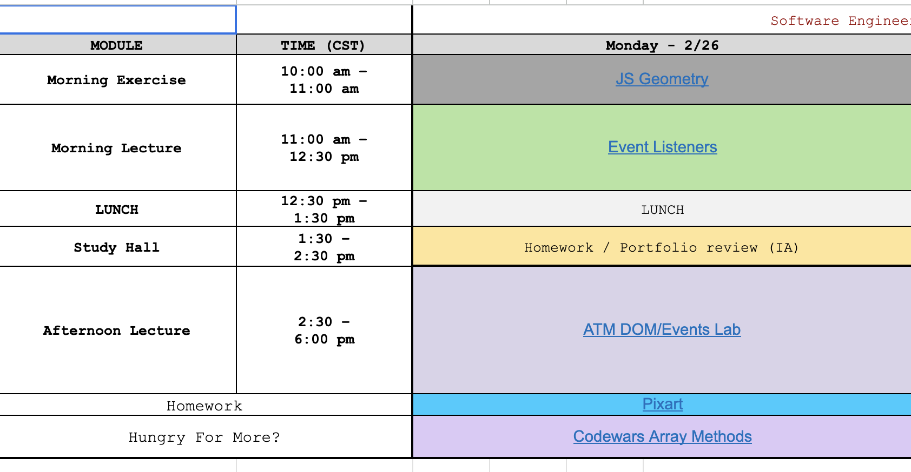
SAMPLE DAILY SCHEDULE
Each day is a mix of learning new material via lecture and applying new concepts directly to exercises or labs that simulate the work you will be doing as a software engineering professional.
Regular breaks are incorporated to ensure you have enough time to recharge throughout the course.
Morning and afternoon stand-ups allow small groups to practice Agile ceremonies.
Notes:
Each day is intentionally designed to be a dynamic experience that both mimics and prepares you for the 9-5 typical work day.
In addition to an hour for lunch, you will have periodic breaks for coffee and water to ensure that you are ready to be active and engaged in our time for coursework, which depending on the day or unit with oscillate between lessons and labs, individual and group work.

Slide 13
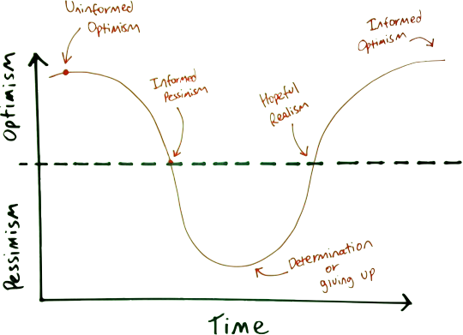
EMOTIONAL CYCLE OF CHANGE
Notes:
IL 1
This experience is going to be really hard, and that’s normal. Everyone will go through an emotional cycle of change.
Learning to ANALYIZE DATA isnt easy, will be something the whole group experiences together.
Can ask a Q: Has anyone learned how to drive stick shift? Etc, How did you feel after you first got behind the wheel. They say X, you can frame it with how morale changes throughout the process.
Can add about the imposter syndrome feeling
Can finish with how everyone in this course is going to be going through a rought time at some point, the timing may differ but as time goes on you will get stronger and hit your stride and reach the informed optimism.

Slide 14

CLASSROOM OPERATIONS
AND EXPECTATIONS

Slide 15
OUR EXPECTATIONS
Treat this as preparation for the digital nature of Software Engineering in the workplace.
We record lessons in case you would like to go back and review!
Slack:
Slack will be an important and frequently used form of communication in class. Be sure to always have this up. Try to avoid using the chat in Zoom unless specifically requested.
Questions, discussions, and links are best shared in Slack
You can use the “Search” tool in Slack to find advice and resources that have been shared
Zoom:
Everyone will be logged in to Zoom each day of class. We will be using Breakout Rooms, where you’ll be collaborating and brainstorming with your classmates.
Be on camera as much as possible, this encourages an interactive environment
Make sure you are muted, unless you are ready to ask or answer a question

Slide 16







KEYS TO SUCCESS
Be Present
Take Breaks
Participate
Be Resourceful
Complete Surveys
Physically and Mentally!
Don’t browse the web or use your phone.
There will be frequent breaks and a 1-hr lunch. Use them to unplug and recharge!
Take notes, ask questions, be engaged, and help your neighbors!
Google and Stack Overflow are your new best friends!
Your feedback makes us better.
16

Slide 17




GRADUATION REQUIREMENTS
ATTENDANCE
You can miss no more than 3 classes. All classes will be hosted on Zoom and Slack. Attendance will be taken daily.
HOMEWORK/LAB PARTICIPATION
Complete minimum 80% of assigned homework. Homework & Lab work will be announced during class.
CAPSTONE & UNIT PROJECTS
Finish and submit unit & capstone projects. Projects will be a mixture of independent & group work and graded based on an agreed upon rubric with specific functional requirements.

Slide 18

PROGRAM TOOLS AND ACCESS

Slide 19

GOOGLE CHROME
Google Chrome is the preferred browser for this course due to its simplicity and ability to load pages, multiple tabs and applications with faster speed than other browsers.
The course content is optimized for use on Google Chrome. If you have not downloaded it already, please follow the instructions below:
Download Google Chrome:
https://www.google.com/chrome

Slide 20
ZOOM
Zoom is our primary communication tool. This is where you will join your class every day to attend lectures. You must have the desktop version downloaded, ensure your are not on the web version
If you have not downloaded it already, please follow the instructions below:
Download Zoom for Desktop:
https://zoom.us/download
Notes:
Purpose: Convey the importance of Slack as a central location for everything/everyone rather than just a chat. They get to keep the history as well.
TALKING POINTS
Post your questions in Slack and NOT in the Zoom chat room. They’ll get lost in Zoom!
Engage with your classmates as much as possible.

Slide 21

SLACK
Slack is our secondary communication tool. Respond to instructors check-ins, share files, lab and activity instructions and other information related to the course.
Find important information in the pinned messages of your class’ Slack channel. Feel empowered to interact with each other and share interesting/fun/cool resources!
If you have not downloaded it already, please follow the instructions below:
Download Slack for Desktop:
https://slack.com/download
Notes:
Purpose: Convey the importance of Slack as a central location for everything/everyone rather than just a chat. They get to keep the history as well.
TALKING POINTS
Post your questions in Slack and NOT in the Zoom chat room. They’ll get lost in Zoom!
Engage with your classmates as much as possible.

Slide 22

VISUAL STUDIO CODE
Visual Studio Code, or VS Code is where you will do all of your coding. VS Code is a lightweight but powerful source code editor which runs on your desktop. It comes with built-in support for JavaScript, TypeScript and Node.js and has a rich ecosystem of extensions for other languages and runtimes.
If you have not downloaded it already, please follow the instructions below:
Download VS Code:
https://code.visualstudio.com/download
Notes:
Purpose: Convey the importance of Slack as a central location for everything/everyone rather than just a chat. They get to keep the history as well.
TALKING POINTS
Post your questions in Slack and NOT in the Zoom chat room. They’ll get lost in Zoom!
Engage with your classmates as much as possible.

Slide 23

JETBRAINS INTELLIJ IDEA
JetBrains IntelliJ IDEA or JetBrains is where you will do all of your coding. JetBrains lets you write high-quality code faster with coding assistance features that search for possible errors and provides improvement suggestions as you type while seamlessly educating you on community best practices in coding, new language features, and more.
If you have not downloaded it already, please follow the instructions below:
Download JetBrains:
https://www.jetbrains.com/idea/download/download-thanks.html
Scroll down to the Free Community version, be sure to select Apple Silicon in the DMG dropdown.
Notes:
Purpose: Convey the importance of Slack as a central location for everything/everyone rather than just a chat. They get to keep the history as well.
TALKING POINTS
Post your questions in Slack and NOT in the Zoom chat room. They’ll get lost in Zoom!
Engage with your classmates as much as possible.

Slide 24

GITHUB ENTERPRISE ACCOUNT
GitHub is a code hosting platform for version control and collaboration. It lets you and others work together on projects from anywhere.
Please create a Username and use the Email we have on file to create your account in GA’s GitHub via:
https://git-invite.generalassemb.ly/invite
*If you already have a personal GitHub account, use the same username and email address*
Shortly, we will open a Slack thread where you can share your usernames and you will be provided access to the Git repositories used in the course.
GitHub, Inc. is an Internet hosting service for software development and version control using Git. It provides the distributed version control of Git plus access control, bug tracking, software feature requests, task management, continuous integration, and wikis for every project.

Slide 25
GITHUB PERSONAL ACCOUNT
Now that you’ve made your GitHub Enterprise Account, create a GitHub Personal Account. This is where you will host your personal work and projects. We recommend using the same email and username you used to create your Enterprise Account
Please create a personal Username and Account in GA’s GitHub via:
https://github.com/signup
GitHub, Inc. is an Internet hosting service for software development and version control using Git. It provides the distributed version control of Git plus access control, bug tracking, software feature requests, task management, continuous integration, and wikis for every project.

Slide 26
Get On Slack
Every session make sure you’re logged into Slack before class starts.
Now let’s go to our workspace:
Software Engineering Bootcamp
Now go to our main program channel
#classroom
Once you’re in give us a hello! 👋
Notes:
Purpose: Get students used to being logged into Slack so that it’s quick and easy to access during class.
TALKING POINTS
This is a good opportunity to allow everyone to log on to Slack and get help.
It’s a good idea to download and install the desktop version.
TEACHING TIPS
Check who hasn’t joined the channel against the attendance sheet and wait until everyone has joined before moving forward.
It may be easier to share an invite link.
See here how to find it: https://slack.com/help/articles/201330256-Invite-new-members-to-your-workspace
From your desktop, click your workspace name in the top left.
Select Invite people to [workspace name] from the menu.
Click Copy invite link.
If you’d like, click Edit link settings to choose an expiration date and decide if you’ll receive notifications from Slackbot when someone uses your link.

Slide 27
Using Slack: Your Profile
5 mins
It’s very helpful to put a face to a name.
Take some time now to add a profile picture if you haven’t already.
Click on your profile picture in the top right.
Select Profile from the menu.
Click Edit.
Under Full Name, please enter your First and Last Name
Under Profile Photo, click on Upload Photo.
Notes:
Purpose: This will help the class get to know each other quicker and better.
TALKING POINTS
If anyone needs directions, share this: https://slack.com/intl/en-gb/help/articles/115005506003-Upload-a-profile-photo
Even if they don’t have a personal photo they feel comfortable with, invite them to use a photo of something they relate to.

Slide 28
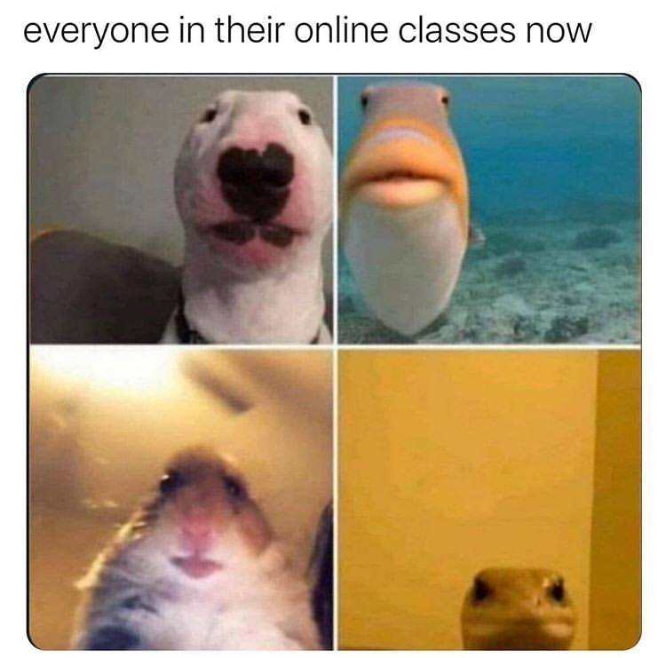
ZOOM
We’re going to spend a lot of time on Zoom so it’s nice to get to know the tool a little better.
We’ll be exploring features such as:
Annotations
Break out rooms
Screen sharing
...and others!

Slide 29



Online Tools
Chat Function
On the rare occasion that we ask you to use Zoom Chat and not Slack.
Raise Hand
Have a question? Use the raise hand feature!
We’ll show you how in a moment.
Annotate Stamps
The stamps in the Annotate feature will be used to cast your vote & get your feedback at different points.
Breakout Groups
Look for these icons for when it’s time to do some group work!
Notes:
We will be using a variety of Zoom tools and functions during our sessions! We will be testing or reviewing all of these today
First is the chat function, which we are now all comfortable using from Trivia. Throughout your sessions we will post comments, and questions in the chat. We will also be administering daily end of day surveys to check how you all are feeling about the lesson that day which will be on screen and also linked in the chat.
We have a raise hand function we’ll test in just a minute or two, that you can use to indicate you have a question during the sessions
Annotate Stamps are a fun feature we will be using to capture your votes and sentiments during the sessions
You have all been placed in Breakout Groups--these will remain the same throughout your 6 sessions, and will be the groups you do group work in. We’ll explain this more in depth in just a bit
Finally, early next week and before SEssion 1 you will be receiving an Editable PDF from me--this is your LIve Online packet, a tool that will enable you to take notes, and collaborate on group work with your team

Slide 30

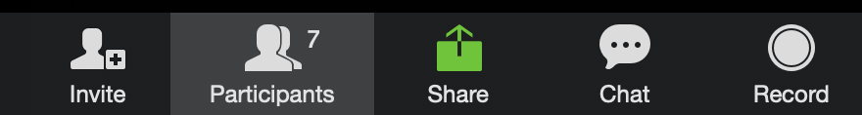
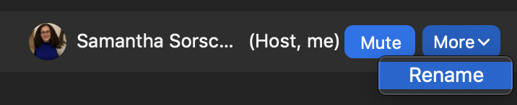
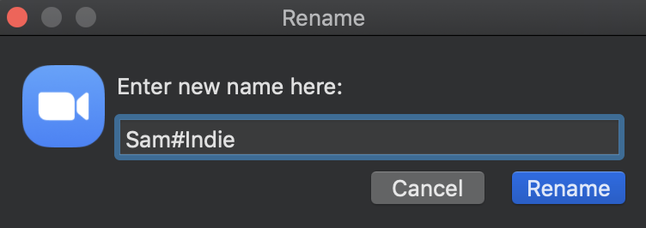
Rename Yourself in Zoom
1
Click Participants at the bottom of the Zoom window.
2
Next, on the right side of the Zoom window:
- Hover over your name.
- Click More,
- Click Rename.
3
Lastly, in the popup box update your Zoom name to:
Your First and Last Name
Notes:
First up, let’s learn how to rename ourselves in Zoom. We do this so that we are able to place you in your proper breakout groups during the sessions

Slide 31
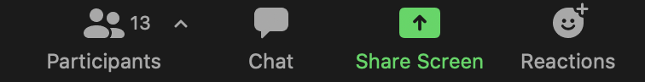
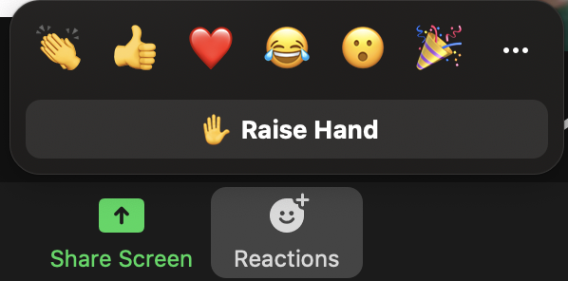
Raise Hand Tool
1
Click Reactions at the bottom of your Zoom window.
Under the various reactions find the ‘raise hand’ button.
On the top right, give a ‘thumbs up’ if you found the ‘raise hand’ icon!
2
3
Notes:
Raise hand tool, again to indicate you have a question or comment!

Slide 32
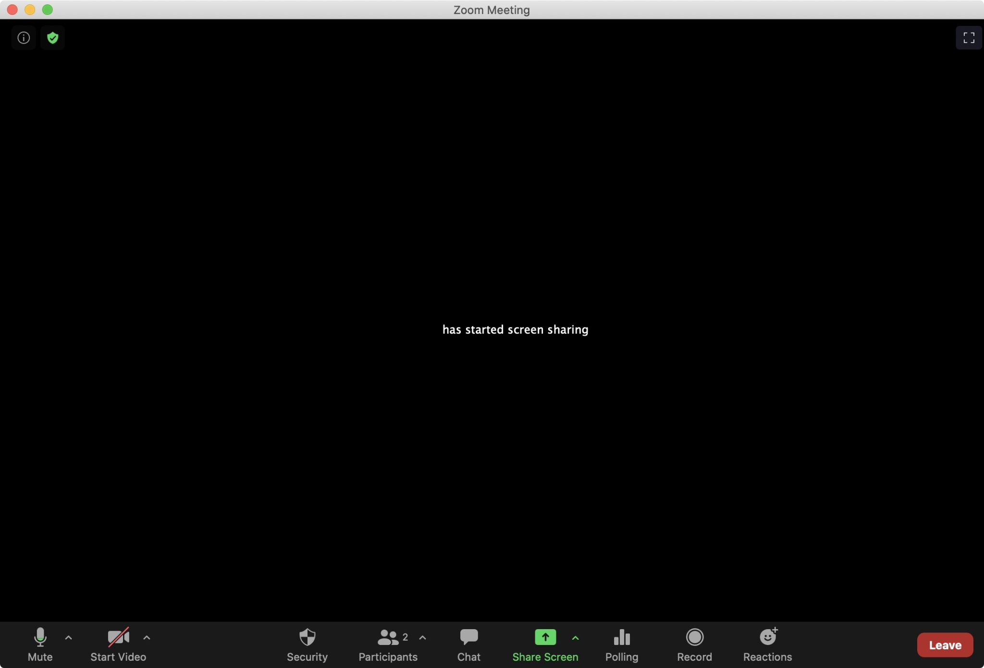
SCREEN SHARING
Sharing your screen during your class will be extremely helpful not just to work together with your colleagues but also for the instructional team to help you troubleshoot.
💡Tip: Before starting class, close down any windows with personal information and keep a tidy desktop.

Slide 33
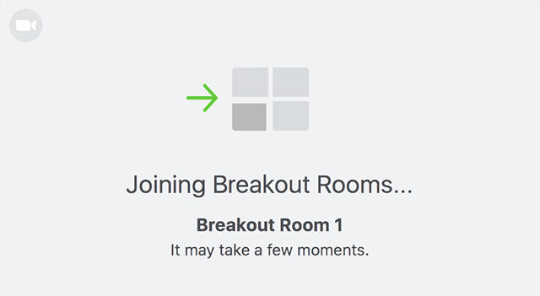
BREAKOUT ROOMS
There will be times when you might be working with your colleagues in smaller virtual breakout rooms.
It may feel a little odd at first but it becomes fun!

Slide 34

ANY QUESTIONS?

